Slide 1
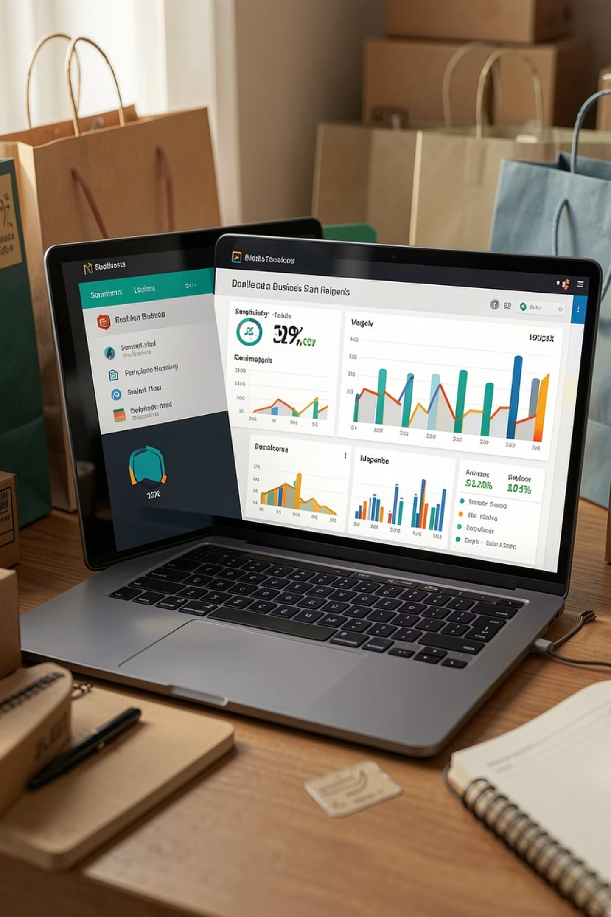
E‑Commerce Analytics using Python, MySQL & Power BI

Slide 2



Roadmap
Introduction & Problem
Dataset & Objectives
Context, motivation, and the business problem
Source, schema, and project goals
Python Pipeline
MySQL Integration
Loading, cleaning, feature engineering, validation
Schema, ETL export, and business queries
Power BI
Findings & Recommendations
Interactive dashboards & KPI visualizations
Actionable business insights and next steps

Slide 3

Introduction
E‑commerce analytics transforms raw transaction and customer data into business value. This project analyzes customer behaviour to inform acquisition, retention, and merchandising decisions using a full end‑to‑end pipeline: CSV → Python → MySQL → Power BI.
Why customer behaviour?
Drives segmentation, personalization, and lifetime value optimization.
Why BI matters?
Turns analytics into interactive insights for timely decisions.

Slide 4

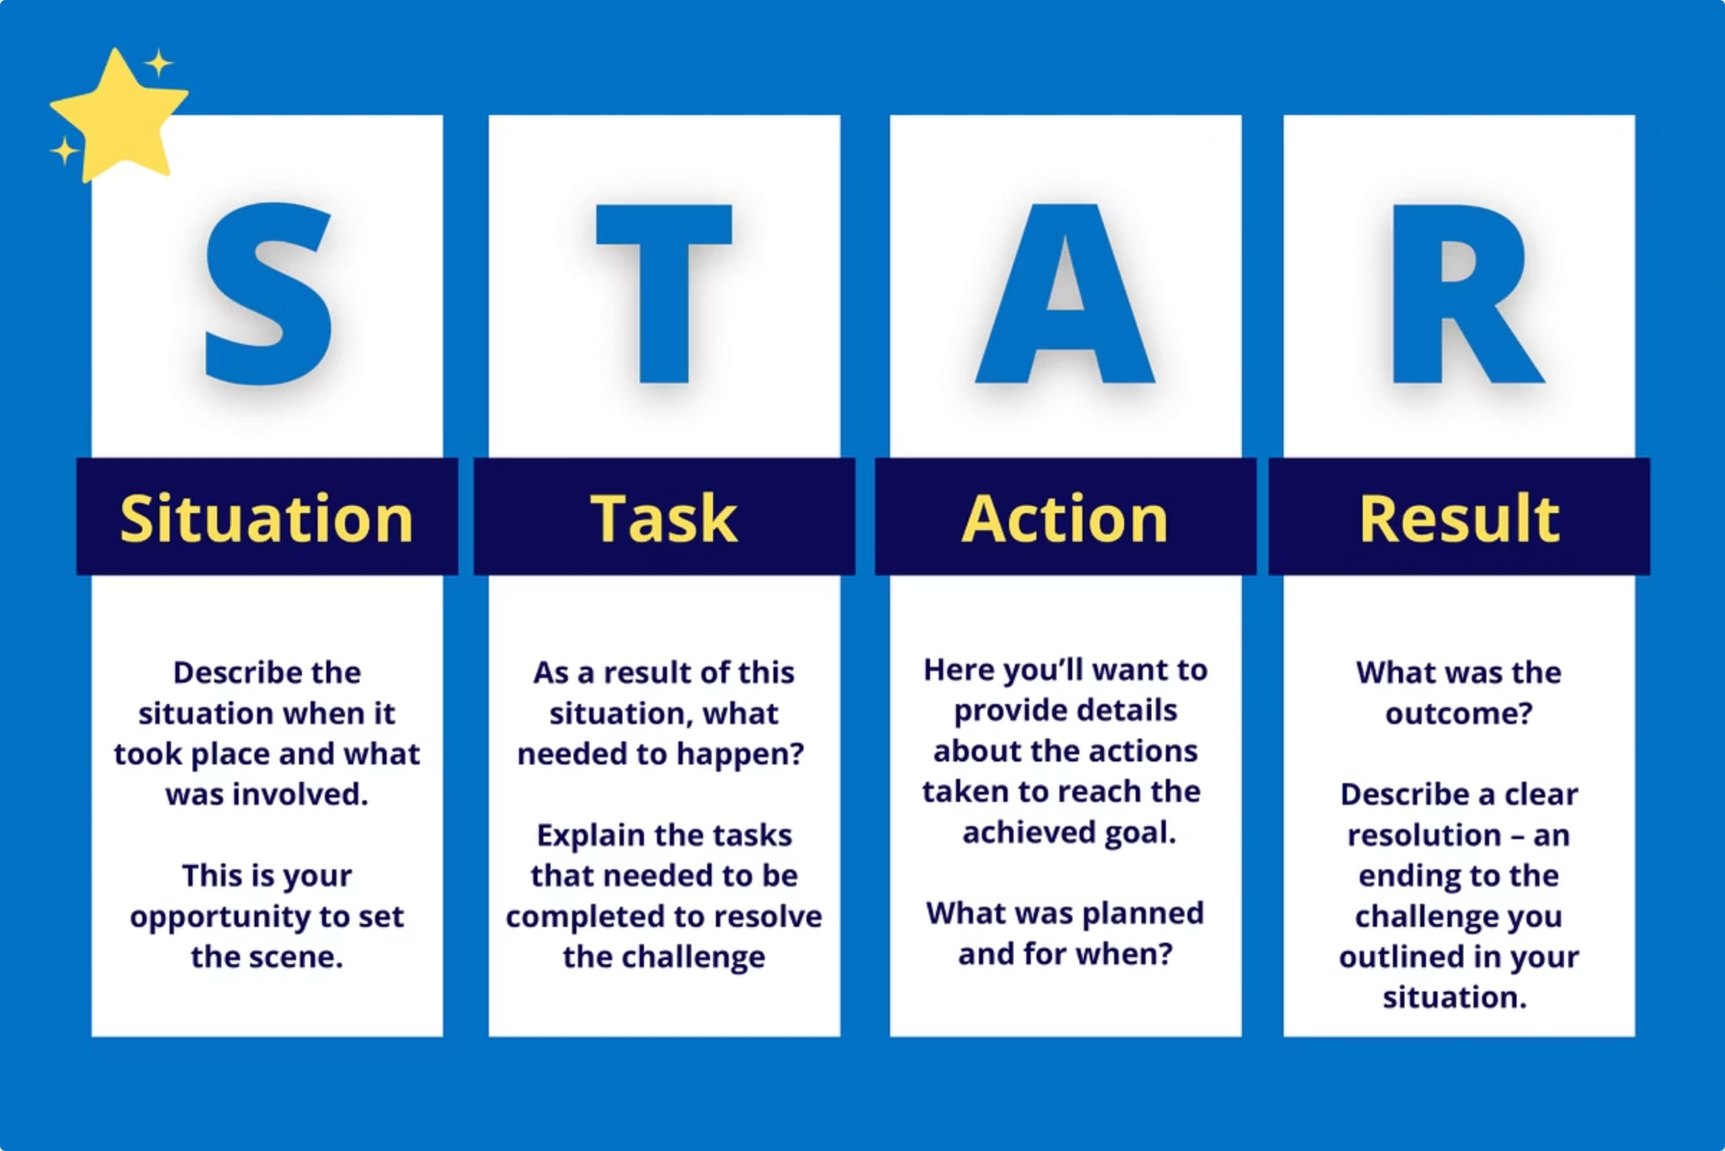
Problem Statement
Organizations collect large customer datasets that remain underutilized: messy CSVs, missing values, inconsistent formats, no segmentation, and static reports — leading to slow or poor decisions.
How this project addresses the gap
Builds a reproducible pipeline that cleans, enriches, validates and publishes data for SQL analytics and interactive BI.

Slide 5




Project Objectives
Customer Segmentation
Revenue Analysis
Subscription & Shipping
Interactive Dashboard
Group users by behaviour and value to enable targeted strategies.
Identify revenue drivers and high‑value cohorts.
Assess subscription uptake and shipping performance impact.
Deliver actionable KPIs and filters for business users.

Slide 6


Dataset Overview
Source: Provided CSV from project documentation. Key facts:
~3,900 customer records
18 columns: customer demographics, purchase details, ratings, subscription, shipping, discounts
Primary use: behavior, revenue and segmentation analysis
All data fields and exact column names used as provided in the documentation.

Slide 7

Technology Stack & Rationale
Python (Pandas)
MySQL + SQLAlchemy
Flexible data loading, cleaning, transformation, and feature engineering.
Persist validated dataset and run performant analytical queries.
Power BI
Jupyter Notebook
Interactive dashboards, slicers, KPIs and story-driven visuals for stakeholders.
Reproducible development environment for stepwise transformation and validation.

Slide 8
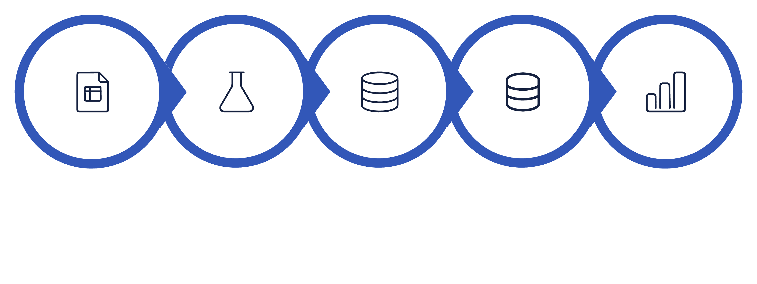
Execution Flow (Architecture)
Export to MySQL
Raw CSV
Python ETL
SQL Queries
Power BI
The diagram above represents an auditable, repeatable ETL pipeline that produces a production‑ready dataset for BI and analysis.

Slide 9

Data Preprocessing & Feature Engineering
Load CSV
Handle Missing
Standardize & Validate
Inspect Schema
Impute & Derive
Key transformations (as implemented in Python): median imputation for numeric gaps, domain rules for categorical fills, derived fields (AgeGroup, PurchaseFrequencyBucket), standardized column names, and final validation checks (record count, null audit).

Slide 10
Python → MySQL → Power BI: Implementation Snapshot
Python Tasks
Export
MySQL Analysis
Power BI
pd.read_csv → initial inspection
Impute missing values (median/mode)
Feature engineering: AgeGroup, Frequency, LTV proxies
Validation: dtype checks, null counts, sample audits
SQLAlchemy engine to upsert cleaned table into MySQL (customer_master, 3,900 rows)
Business queries: revenue by gender, age, product category
Window functions for repeat buyers and RFM-like grouping
Materialized views used as Power BI sources
Import SQL views, build star-like model, create KPIs, charts, slicers (date, category, age group), and publish interactive report.

Slide 11

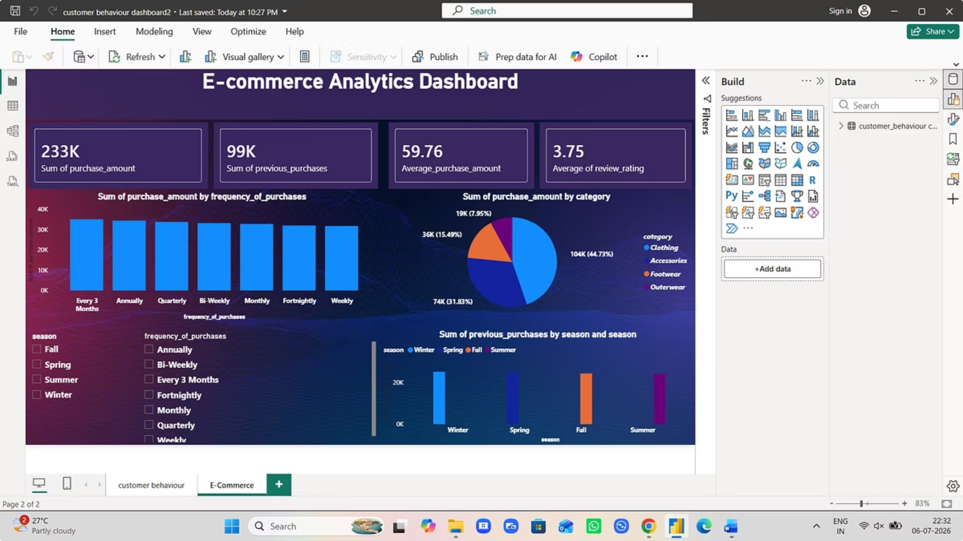
E-Commerce Analytics Dashboard
231K
Total Purchases
99K
Unique Purchases
59.76
Avg. Purchase
3.75
Avg. Online Rating

Slide 12

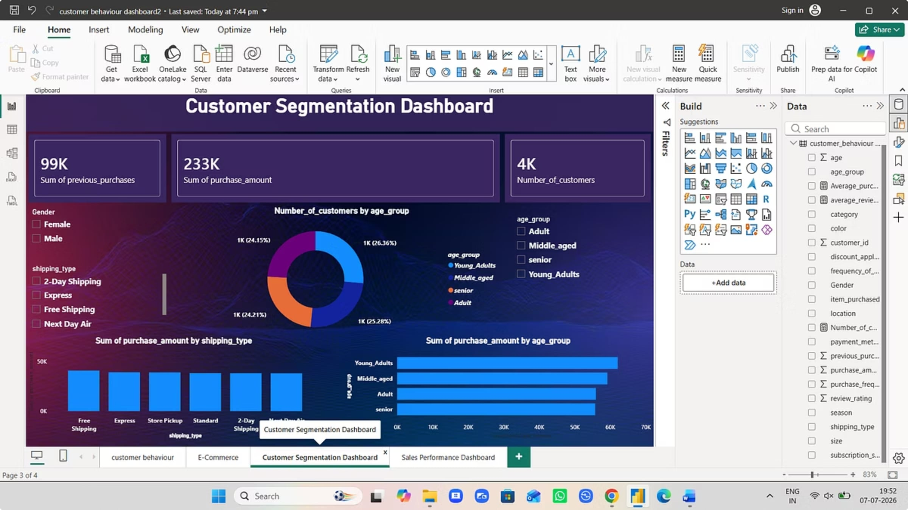
Customer Segmentation Dashboard
99K
Total unique customers
233K
Total customers analyzed
4K
High-value customer segment

Slide 13

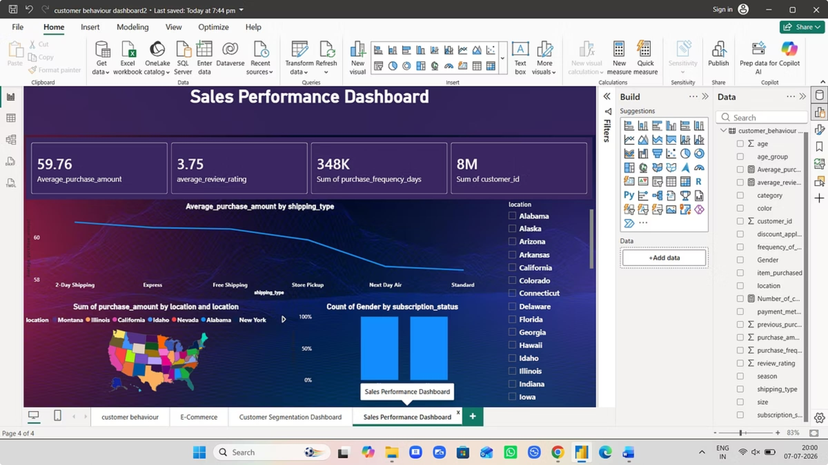
Key Metrics:
Sales Performance Dashboard
Average purchase amount
Average customer rating
59.76
3.75
Total purchase frequency
Total revenue generated
348K
8M

Slide 14

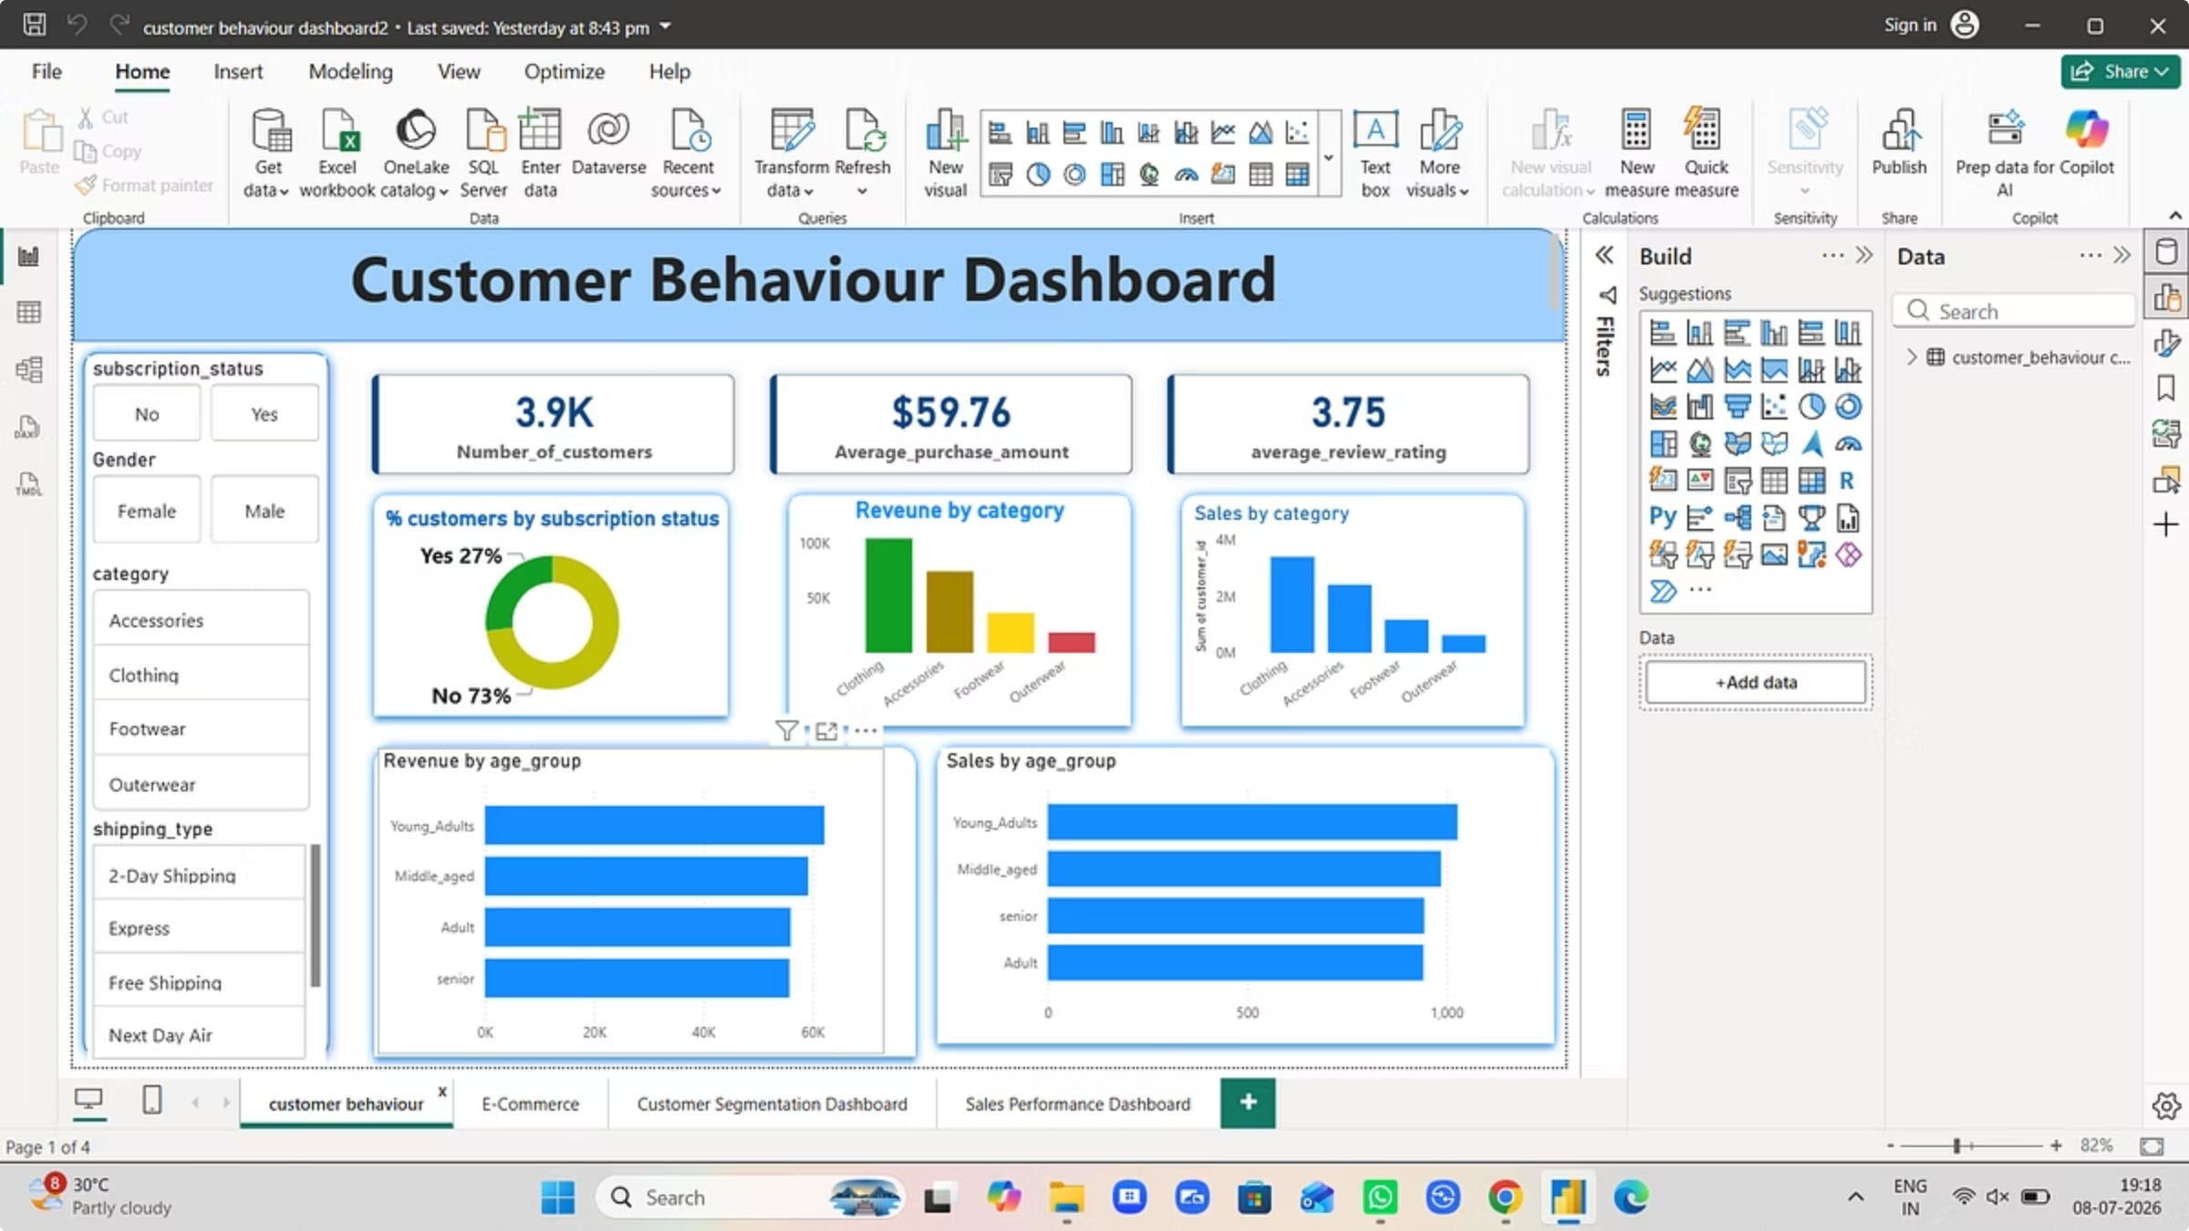
Customer Behaviour Dashboard
Key Metrics:
Total customer
records
Average purchase
value
Average satisfaction
rating

Slide 15
Key Findings & Recommendations
Main takeaways in simple terms.
Key Findings
Strategic Recommendations
Technical Achievements
☑ 231K purchases, 99K unique buyers, and 4K top-value customers.
☑ Focus on your best customers.
☑ Combined the data in one place.
☑ Encourage repeat buying.
☑ Made the results easy to read.
☑ Average purchase was $59.76 and average rating was 3.75.
☑ Promote what works best.
☑ Found the main drivers of sales.
☑ Sales reached 348K purchases and $8M in revenue.
☑ Plan ahead for busy times.

